Slide 1
Introduction to Web Services

Slide 2
What are Web Services?
A web service is a software component present on a server that allows two applications to communicate over the internet using standard protocols.
👉 In simple words:
A web service helps one application talk to another application.
Why Web Services?
Applications are built in different languages
(Java app + .NET app + Python app)
They still need to communicate
Web service works as a common language between them

Slide 3
web service exposes a set of URLs called APIs.
Client applications call these URLs and get data back.
Realistic Example
Swiggy Data Flow
Swiggy App → Calls API: /getRestaurants
Server returns JSON list of restaurants
App displays it to user
Behind the scenes:
Mobile app (Flutter/React Native)
Server (Java / Node.js / Python)
Database (MySQL / MongoDB)
They all communicate via web services.

Slide 4
Types of Web Services
SOAP Web Services
  Uses XML only
  Strict, secure, enterprise-style
REST Web Services
  Uses HTTP
  JSON, XML, Text, HTML
  Lightweight & widely used

Slide 5
Realistic Example
When you order food from Swiggy, your app calls REST APIs
“Get Restaurants”, “Get Menu”, “Place Order” — all are web services.

Slide 6
Client
Anything that sends a request:
Browser (Chrome, Firefox)
Mobile App
Postman
React/Angular frontend
✔ Server
Anything that receives the request & sends back data:
Java Spring Boot API
Node.js Express backend
Python Django/Flask service
.NET Core API

Slide 7
Flow
Client sends request
Server processes it
Server returns response
Realistic Example
Browser → Google Server
You type “IPL score” → send request
Google returns response → result shown

Slide 8
How Client–Server Works (Step-by-Step)
Step 1 — Client sends a Request
Example Request (GET):
GET /students HTTP/1.1
Host: myschool.com

Slide 9
Step 2 — Server Processes
Server checks:
URL
Parameters
Authentication
Database
Step 3 — Server Sends Response
200 OK
{
"students": [
{"id": 1, "name": "John"},
{"id": 2, "name": "Anita"}
]
}

Slide 10
Realistic Example: Amazon Product Page
Client → “Show me shampoo”
Server → Finds products in database & responds with JSON
Your browser formats the data into a UI.

Slide 11
HTTP Protocol – Deep Explanation
HTTP = Hypertext Transfer Protocol
A set of rules for communication on the internet.
📌 HTTP Methods (Full Meaning)
1️⃣ GET – Read Data
Example:
GET /products
Used when:
Searching products
Viewing profile
Getting dashboard data

Slide 12
POST – Insert Data
Example:
POST /register
{
"name": "Arjun",
"email": "arjun@gmail.com"
}
Used when:
Creating account
Adding order
Payment processing

Slide 13
PUT – Full Update
Example:
PUT /users/10
Used when:
Editing profile
Changing entire object
4️⃣ PATCH – Partial Update
Example:
PATCH /users/10
{
"email": "newmail@gmail.com"
}

Slide 14
DELETE – Remove Data
Example:
DELETE /cart/5

Slide 15
HTTP Request – Detailed Structure
Request Example
POST /login HTTP/1.1
Host: myapi.com
Content-Type: application/json
Authorization: Bearer abcd1234
{
"email": "jinu@gmail.com",
"password": "12345"
}
Important Parts
Request Line → POST /login HTTP/1.1
Headers → Content-Type, Authorization
Body → JSON Data

Slide 16
JSON – In Depth Concept
JSON = JavaScript Object Notation
Used widely in mobile apps, web apps, cloud applications.
✔ Features
Lightweight
Easy to read
Fast
Supports objects & arrays
JSON Example
{
"id": 101,
"name": "Arjun",
"skills": ["Java", "React", "SQL"],
"salary": 45000,
"active": true
}

Slide 17
Realistic Example (Uber App)
Uber API sends:
{
"driver": "Ravi",
"car": "Swift",
"arrivalTime": 3
}
Mobile app uses this JSON to show:
driver name
car model
arrival time

Slide 18
HTTP (Hypertext Transfer Protocol)
Rules for communication between client & server.
Common HTTP Methods
Method | Meaning | Example
GET | Read data | get list of students
POST | Insert data | add new student
PUT | Update | update profile
DELETE | Remove | delete student

Slide 19
HTTP Status Codes
Code | Meaning
200 | OK
201 | Created
400 | Bad Request
401 | Unauthorized
404 | Not Found
500 | Server Error

Slide 20
Realistic Example
If your mobile app tries to fetch details of a deleted product → 404 Not Found.

Slide 21
Deep Dive: HTTP Request & Response
HTTP Request Format
POST /login HTTP/1.1
Host: myapp.com
Content-Type: application/json
{
"email": "user@example.com",
"password": "12345"
}

Slide 22
HTTP Response Format
HTTP/1.1 200 OK
Content-Type: application/json
{
"message": "Login successful",
"token": "ABCD1234"
}

Slide 23
Headers
Content-Type
Authorization
User-Agent
Cache-Control
Realistic Example
Mobile app sending JWT token to access user profile.

Slide 24
JSON Explained
JSON (JavaScript Object Notation)
Lightweight data format, easy to read.
JSON Syntax Example
{
"id": 1,
"name": "Arjun",
"skills": ["Java", "Spring", "SQL"],
"active": true
}

Slide 25
Why JSON is Popular
Easy for humans
Easy for machines
Works perfectly with JavaScript
Lightweight
Realistic Example
Every mobile app uses JSON — WhatsApp, Facebook, Amazon, Banking apps.

Slide 26
XML Explained
XML (Extensible Markup Language)
Used in older systems, very structured.
Example
<Employee>
<Id>1</Id>
<Name>Arjun</Name>
<Salary>45000</Salary>
</Employee>

Slide 27
XML – In Depth Concept
XML = Extensible Markup Language
Mostly used in enterprise & government systems.
XML Example
<Employee>
<Id>101</Id>
<Name>Arjun</Name>
<Salary>45000</Salary>
<Active>true</Active>
</Employee>

Slide 28
JSON vs XML – Clear Comparison
Feature | JSON | XML
Format | {} | <tags>
Weight | Lightweight | Heavy
Speed | Faster | Slower
Readability | Very easy | Complex
Used In | REST APIs | SOAP APIs
Data Type Support | Rich | Limited

Slide 29
JSON vs XML
Feature | JSON | XML
Weight | Light | Heavy
Readability | Easy | Hard
Used In | REST | SOAP
Tags | {} | <tag>

Slide 30
Realistic Use Case
Banks & government systems still use XML due to strict data structure requirements.

Slide 31
Final Combined Infographic (Client-Server + HTTP Flow + JSON vs XML)
Below is a single composite image containing:
✔ Client–Server Model
✔ HTTP Request/Response Flow
✔ JSON vs XML comparison

Slide 32
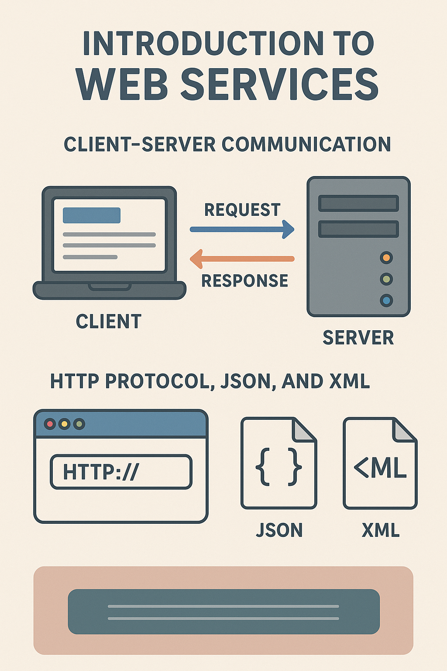

Slide 33
THANK YOU

